Slide 1
ALS Beer Recommendation System
CIS 5367 ML Project
Daniel Lopez
Deboprosad Roy
Jason Oliver
John Greenhaw
Karen Cenal

Slide 2
Presentation Outline
Hypothetical Scenario
Our Machine Learning System
Use-Case - bold because we may/may not use
Data Sources
Beer Data
Reviewer Data
Brewery Data
ALS Model Fields

Slide 3
Hypothetical Business Scenario
Still not exactly sure what our scenario is/ will be. That’s why this slide is extremely broad for now.
Somehow helping beer companies with a recommendation system to…?
Maybe it’s promotional? For example, a company wants to try an ALS for marketing their new beer recommendation system to consumers.
Could also be trying to get people to use the beer review to get more flow to their website?

Slide 4
ALS Recommendation System
All data is subject to change given our scenario.
ALS Beer Recommendations
Will provide users beer recommendations based on their precious scores/ratings.
Also provides where and when the beer can be had.
How will it enhance current systems
Will be based on our hypothetical scenario.
Could it replace current systems?
Will be based on our hypothetical scenario.
Our Modeling system could be called Brew4U? Catchy name, easy to sell.

Slide 5
ML Use Case Presentation?
Optional use-case for our ML model to demonstrate effectiveness/capability of the ALS. - Skipped for now.

Slide 6
Data Sources
Beer Data
Reviewer Data
Brewery Data

Slide 7
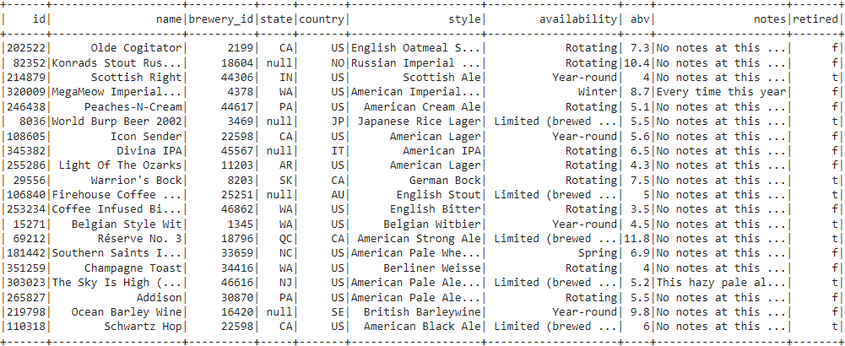
Data Source 1
Beer Data - Provides information related to each available beer.
Beer ID
Name
Brewery ID
State
Country
Style
Availability
ABV (alcohol by volume)
Notes
Retired

Slide 8
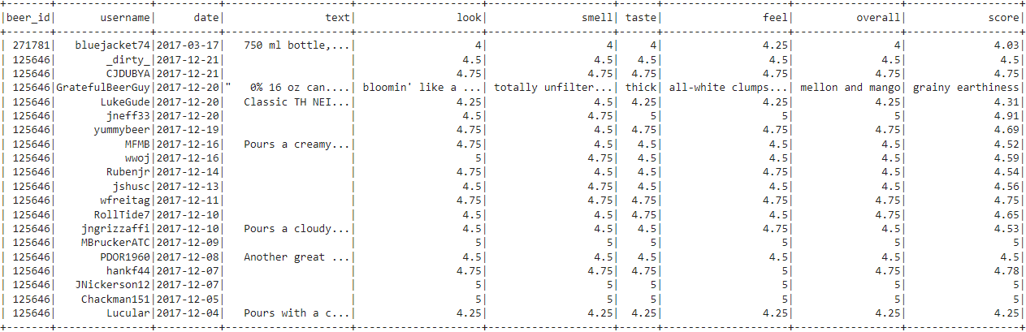
Data Source 2
Review Data - Provides background and rating data that a user has given to a beer.
Beer ID
Username
Date
Text
Look
Smell
Taste
Feel
Overall
Score

Slide 9
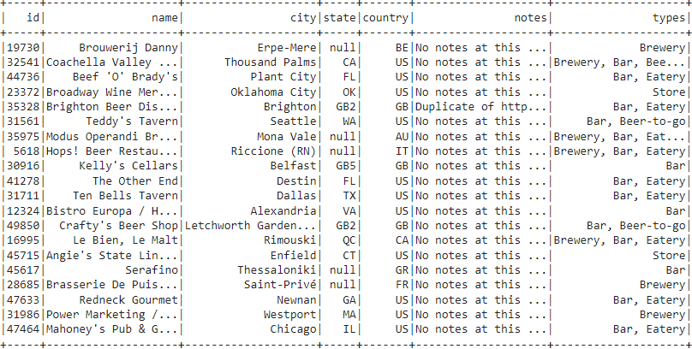
Data Source 3
Brewery Data - Provides data relating to each brewery where the beers are available.
Brewery ID
Name
City
State
Country
Notes
Types

Slide 10
Fields Used in ALS Model
Fields used to provide beer name and brewery name to the user.
Beer ID - Numeric Identifier for each beer.
Brewery ID - Numeric Identifier for each brewery.
Score - Numeric Identifier demonstrating the User’s 1-5 rating of the beer.
? - any additional info we may want to include.
I’m not including things like brewery name, location, beer name, etc as they’d be derived from ALS, and joined not necessarily in it.

Slide 11
Questions?

